Slide 1
DATA 601 – Lecture 01 Data Science Concepts and Workflows
UMBC Data 601
Instructor: Felix Gonzalez
fgonzale@umbc.edu

Slide 2
What is DATA SCIENCE?

Slide 3
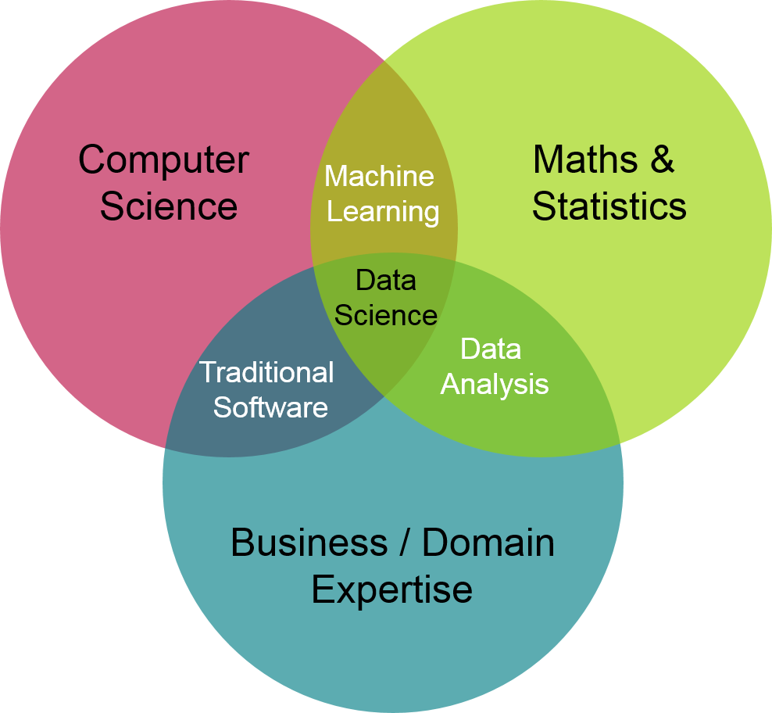
What is Data Science?
Image Source: The Mostly Color Channel: Data Analysis Careers

Slide 4
What is Data Science?
Artificial
Intelligence (AI)
Data Science
Data Analytics
Machine
Learning (ML)
Natural Language Processing (NLP
Statistics
Deep Learning (DL)
Generative AI
Notes:
In the last few years, interest in data science, big data, artificial intelligence (AI), machine learning (ML) and natural language processing (NLP), robotic process automation and other emerging technologies continues to increase exponentially. These fields, eventhough related, are also very difficult to define as they are very broad and encompasses the application of various other fields.

Slide 5
Data Science Definitions
Data Analytics: Obtaining and transforming data to obtain insight and produce visualizations that aid decision-making
Artificial Intelligence: Ability for a machine to emulate reasoning, knowledge representation, learning, language processing and decision making.
Machine Learning: (part of AI) machine is taught to learn and understand data to make decisions without explicitly being programmed to do so.
Big Data: Large volumes of data that are too large or complex to be dealt by traditional analysis and processing methods.
AI Algorithm: Computer code/instructions/steps that simulate logic.
Generative AI: Tools that accept a prompt as input to generate human-like output (e.g., text, images, video, sound, etc.)
Data Science: Unification of all the above (and more) to analyze and obtain insights from data.
Emerging Technologies: Emerging Technologies per S.1605 - National Defense Authorization Act for Fiscal Year 2022, 117th Congress (2021-2022), Public Law 81:
“The term emerging technology means technology jointly determined to be in an emerging phase of development by the Secretary of Defense and the Director of National Intelligence, including quantum information science and technology, data analytics, artificial intelligence, autonomous technology, advanced materials, software, high performance computing, robotics, directed energy, hypersonics, biotechnology, medical technologies, and such other technology as may be jointly identified by the Secretary and the Director.”
Subject Matter: Topic for which emerging technologies is being applied (e.g., health, cybersecurity, transportation, etc.).
Notes:
The following definitions are an attempt to simplify the meaning of various interactions between various fields that are used in data science. Various definitions exist and is my advice to not focus on where one begins and ends but rather focus on what is the goal.

Slide 6
Data Science Process
Define scope and formulate question to the problem
Overview of Typical Data Science Problem Process
Data Collection
Example Data Science Jargon:
Data cleaning
Data preparation
Data wrangling
Data transformation
Data augmentation
Data pipeline
Exploratory Data Analysis
AI and ML
Data cleaning
(e.g., duplicates, errors, missing values, etc.)
Data transformation, derived features, NLP
Iterative process
Outputs in any one step may result in revising a previous step
Exploratory Data Analysis and Data Visualization
Apply AI/ML
Data visualization, decision, communication (e.g., report)
Notes:
Many of the terms in this slide are often used interchangeably, their definitions can vary from various data analytic and data science commercial tools and frameworks and have various levels of overlap. We will talk about these during the class.
If this is an application that utilizes AI algorithms, it will also include other common software development practices such as the ones highlighted below:
Defining scope, formulating question and identifying funding
Planning designing, procuring, developing system
Data Cleaning; may also be referred as data preparation, data wrangling, data transformation, data profiling, data pipeline. This step may also include defining data transformation needed (e.g., deriving features, scaling, and/or normalization).
Exploratory Data Analysis (EDA) and data visualization
Defining task to be performed or task that the data allows to be performed
Define data variables and features to be used in models and algorithms (e.g., independent vs. dependent variables)
Applying AI/ML Algorithms: Training, testing, evaluating, verification, and validation of model and algorithm performance
EDA, Documentation and model deployment
Monitoring

Slide 7
AI/ML/NLP Application
If an application is utilizing AI algorithms, steps may also include other common software development practices such as the ones highlighted below:
Defining scope, formulating question and identifying funding and available resources
Planning designing, procuring, developing system
Data collection and procurement (i.e., data may already exist or may need to be collected)
Data Cleaning; may also be referred as data preparation, data wrangling, data transformation, data profiling, data pipeline. This step may also include defining data transformation needed (e.g., deriving features, scaling, and/or normalization).
Exploratory Data Analysis (EDA) and data visualization
Defining task to be performed (or task that the data allows to be performed)
Define data variables and features to be used in models and algorithms (e.g., independent vs. dependent variables)
Applying AI/ML Algorithms: Training, testing, evaluating, verification, and validation of model and algorithm performance
EDA, Documentation and model deployment
Monitoring of system and model performance
Notes:
This course does not focus on application development but rather the concepts tha allow development of an AI/ML/NLP model and system.

Slide 8
Common Tasks within AI/ML/NLP
Classification (e.g., email classification, image recognition)
Predictive Analytics (e.g., recommendation systems, predictive maintenance, anomaly detection)
Clustering (e.g., customer segmentation, anomaly detection, text clustering)
Information retrieval and ranking
Named entity recognition
Text summarization
Question answering (e.g., chatbots)
Generative AI (e.g., large langauge models, ChatGPT)

Slide 9
Other Data Science Topics
Amount of data. Evaluate if there is enough data for dividing the dataset into training/testing (typically 80/20).
Big Data => Data => Enough Data
Synthetic or augmented data
Data quality
Database error rates (i.e., acceptable vs. unacceptable)
Data balance (e.g., are all classes represented)
Data bias: any biases in the data most probably, knowingly or unknowingly, will also show in the outputs of the model
Scaling
Multi-Collinearity
Explainability
Model performance metrics (e.g., metrics calculations, prediction performance, use of model, etc.)
Ethics

Slide 10
Knowledge Management Lifecycle
Knowledge Creation and Discovery
Knowledge Monitoring
Knowledge Capture and Curation
Knowledge Leverage
(e.g., decision making)
Knowledge Retrieval (e.g., ranking, analysis)
Knowledge Sharing (e.g., dissemination)
Notes:
In practice, the topic of knowledge management may also be important as data science may provide important tools and insights throughout the knowledge management lifecycle.

Slide 11
Lots of Tools and Platforms
Tools often have a combination of capabilities (e.g., visualization, AI, ML, NLP, etc.). Examples of readily available tools:
Open source (e.g., Python, R, Jupyter, JSD3, etc.)
Example of data analytics and data science platforms all with different capabilities, limitations, and learning curves:
Anaconda (Data science distribution package Python/R/Jupyter)
NVIDIA Deep Learning Institute (DLI)/Data Science Libraries (e.g., RAPIDS)/Omniverse
Google Cloud Services Platform
Amazon Web Services
MicroStrategy
MS Power Apps/Power Bi/Azure
Tableau
Hadoop
Palantir Foundry
SkySpark
PNNL Inspire (text analysis)
Other low code or no-code development platforms
Jargon can vary from company to company from tools to tools.

Slide 12
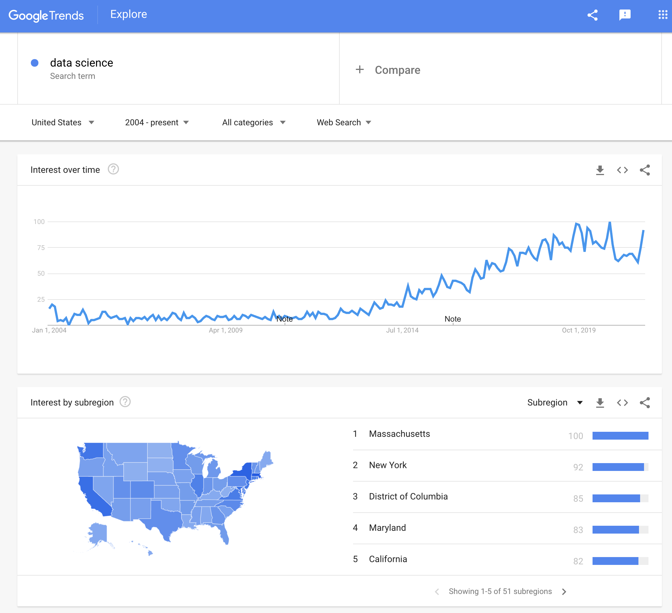
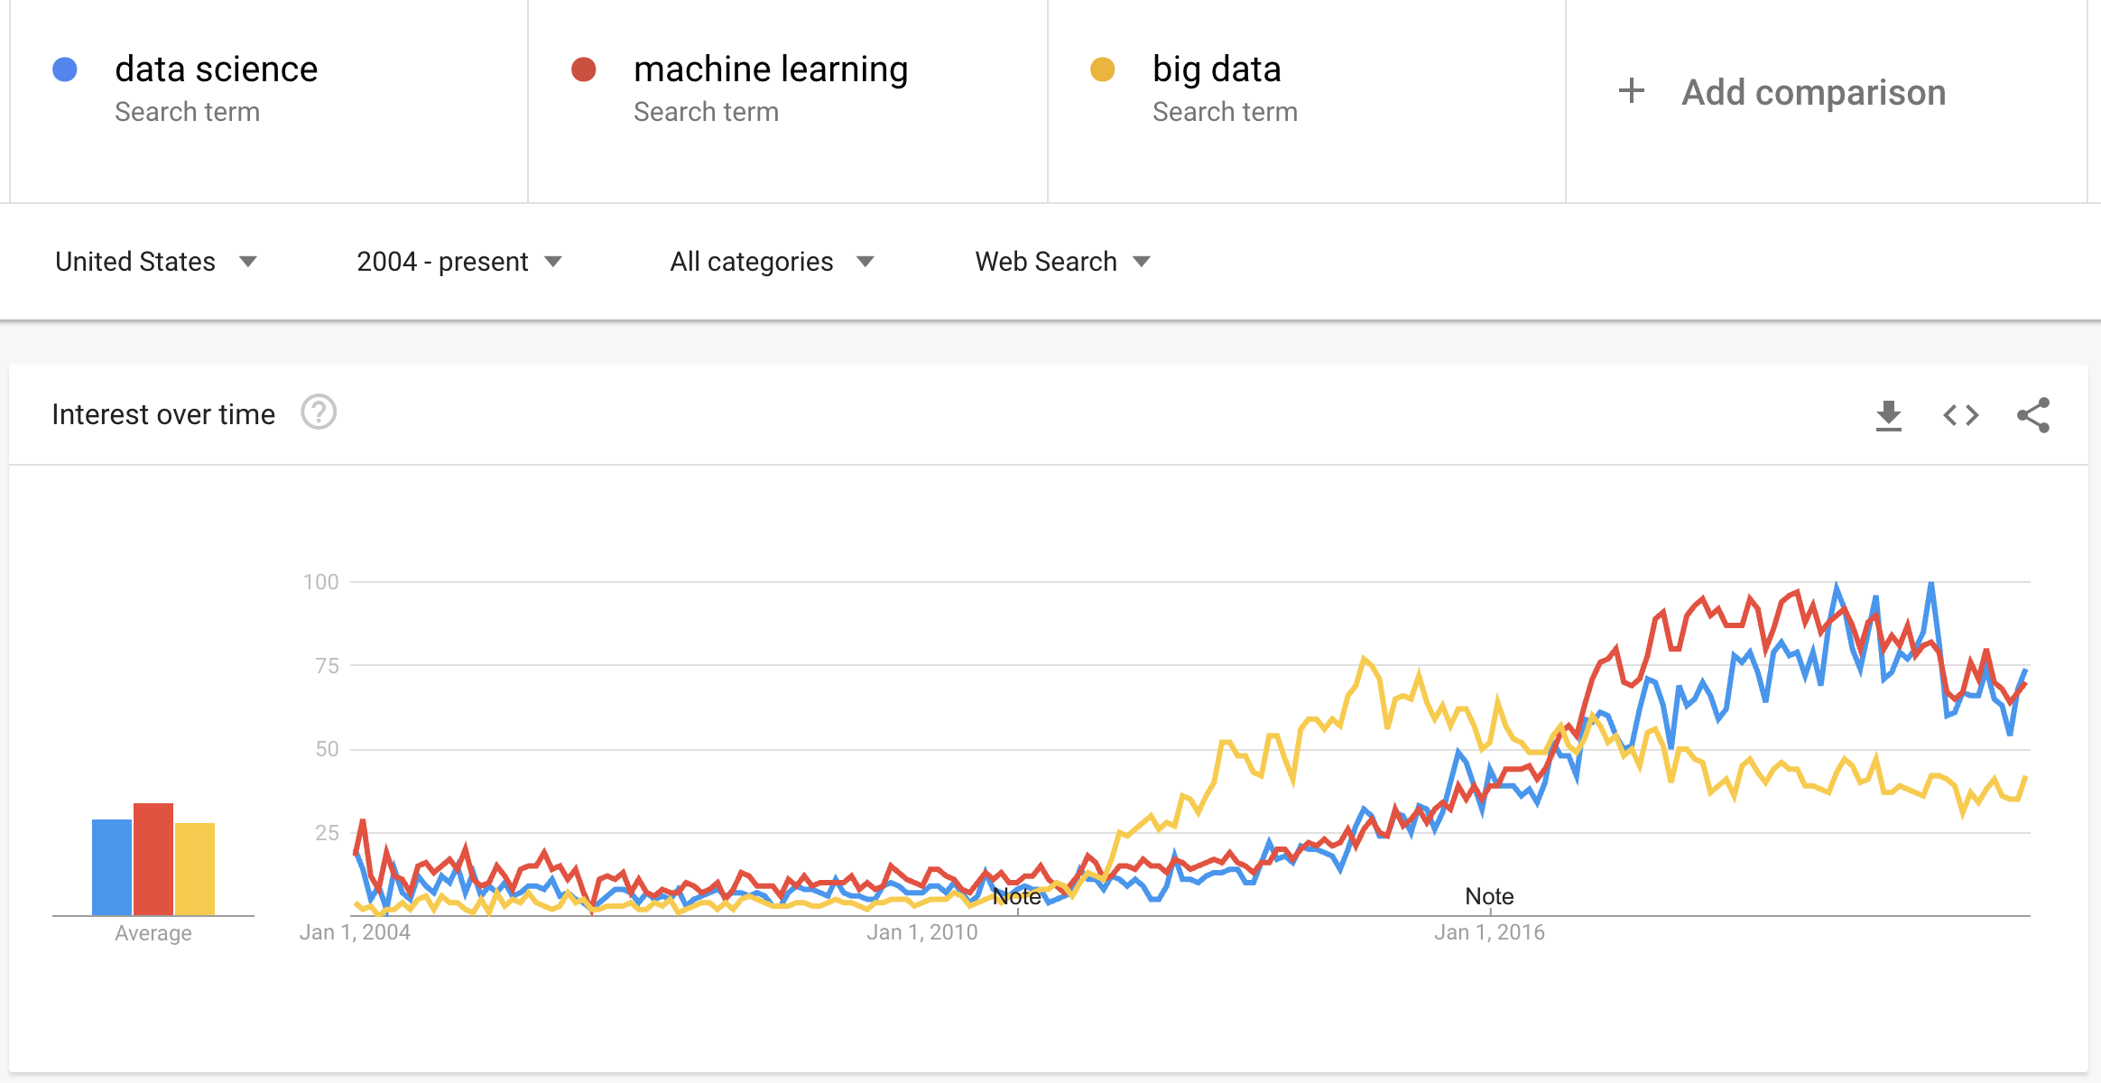
DS is an active field
Increasing interest in the DS field
Evolving field: There will always be something you haven't heard of before
Be curious about new topics
Know enough to be conversant with peers
Research concepts and labels before using them
Lots of jargon
Reference:
http://www.datascienceglossary.org/

Slide 13
The World of DS is Huge. Don’t get lost!

Slide 14
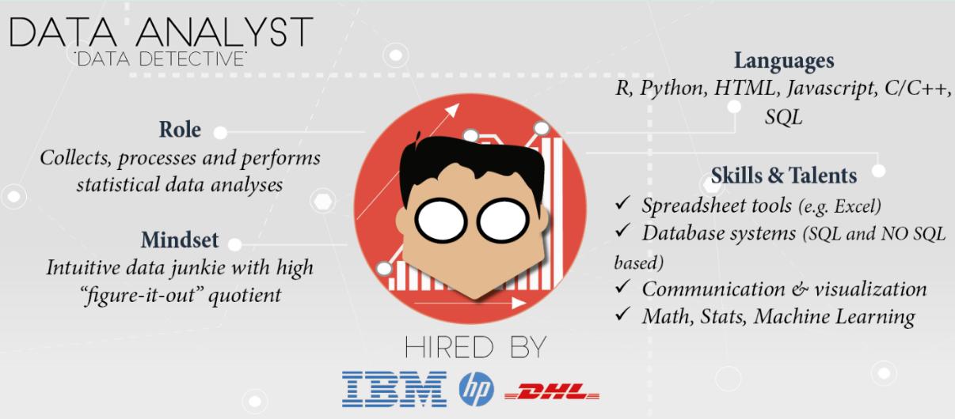
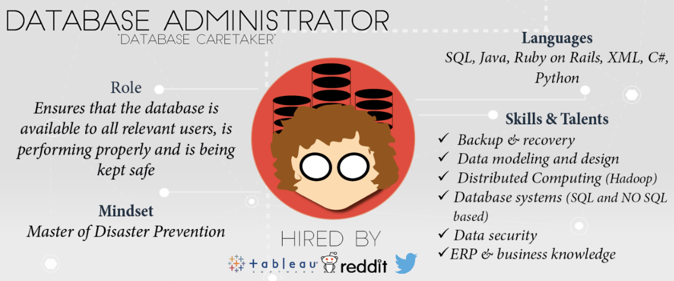
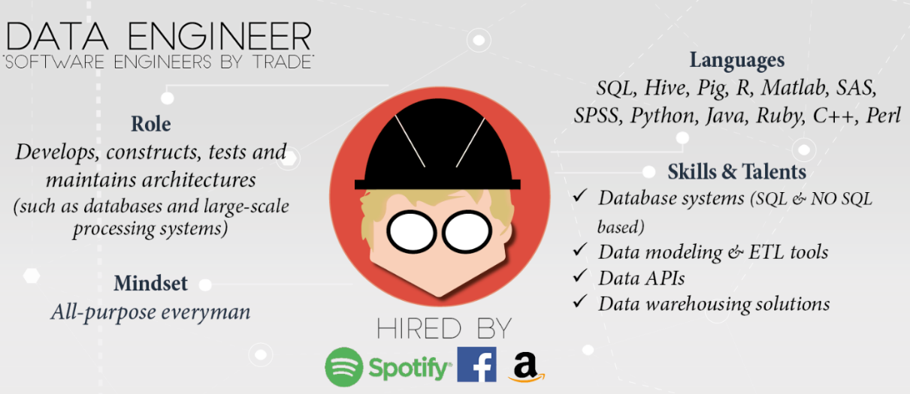
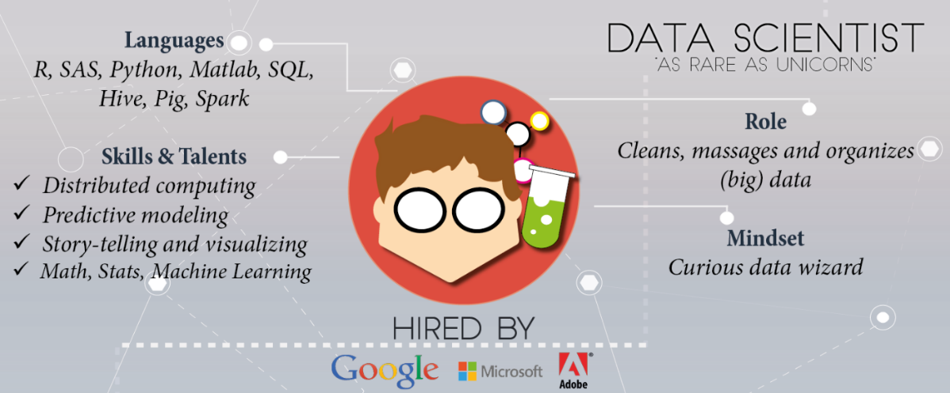
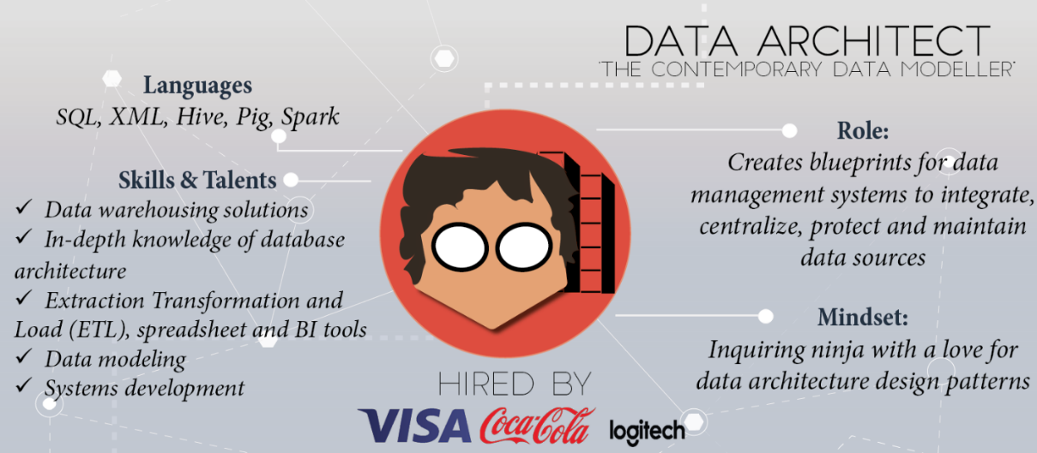
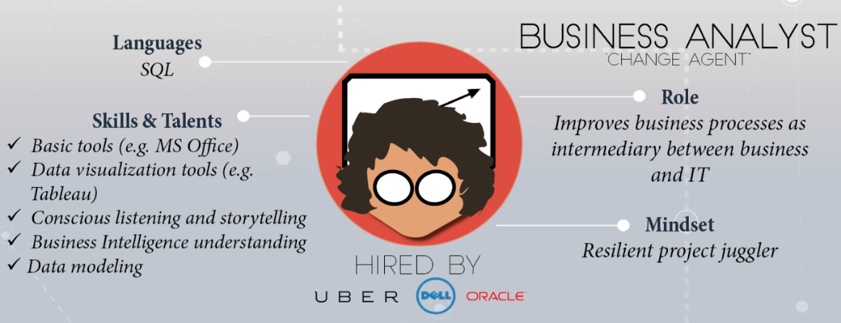
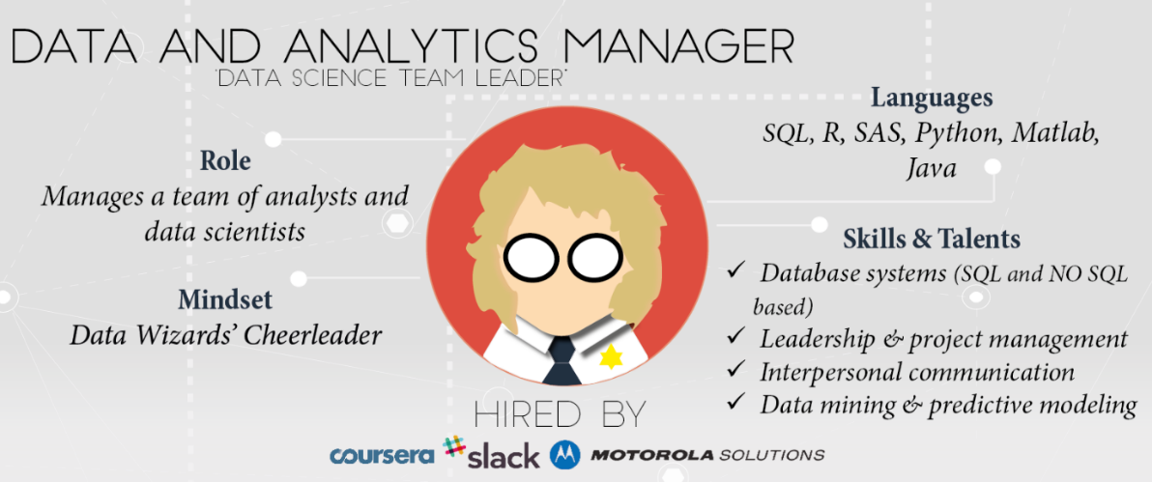
Skills and experience matter more than title and labels
https://www.datacamp.com/community/tutorials/data-science-industry-infographic
Historical progression: data grooming, data mining, data scientist

Slide 15
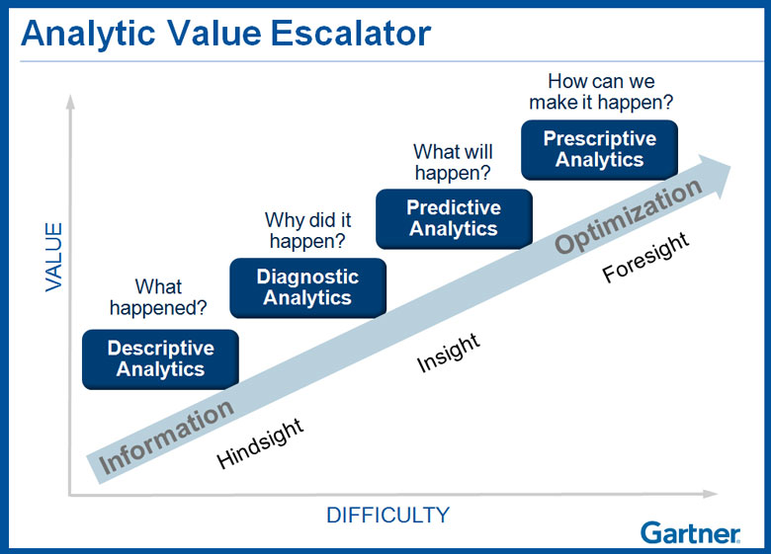
Why learn data science?
Explore: identify patterns​
Predict: make informed guesses​
Infer: quantify what you know
Motives:
Make money
Employment
Promotion
Help people
Gain new knowledge
Career opportunities

Slide 16
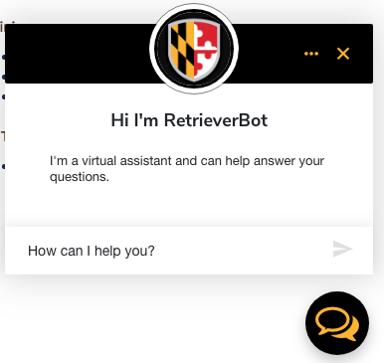
Large scale use cases with lots of data
Information Retrieval:
Google's search engine
Chatbots
Bank and Credit Card fraud detection
Logistics (e.g., DHL, UPS) of fleet management
Healthcare records from patients
Each depends on availability of compute and data
Notes:
https://www.thrillist.com/entertainment/nation/how-new-netflix-recommendation-algorithm-works#
https://medium.com/netflix-techblog/artwork-personalization-c589f074ad76
https://www.wired.co.uk/article/how-do-netflixs-algorithms-work-machine-learning-helps-to-predict-what-viewers-will-like

Slide 17
Assumption in this class
In class we will assume you are a lone data scientist on an island with an internet connection.
This is not the typical case - you'll have various stakeholders coworkers, customers, bosses, competitors, collaborators, peers.
Example of how class ≠ real world
This class will not use competitive grading. (Imagine if it were.)
As an employee at a company, you may be competing for a bonus or promotion
Consequence: personal and organizational politics factor into the work environment

Slide 18
Small scale use cases with not much data
As a business employee, bureaucrat or politician
How do I improve decision making process?
How do I evaluate the outcome of decisions?
How do I decrease the risk when faced with an opportunity?
How do I convince other stakeholders of the best course of action?
While not taking too much time, spending too much money, using the resources I already have access to, and in a way that is convincing?

Slide 19
Class Main Tools
Python with Jupyter Notebooks
Anaconda Data Science Platform (https://www.anaconda.com/)
GitHub (https://github.com/fgonzaleumbc/DATA601)
Blackboard (https://my.umbc.edu/)
Google Colab (https://colab.research.google.com/)
Google Drive (https://drive.google.com)

Slide 20

Assumption in this class
Jupyter is useful for:
Exploration of data (jargon: EDA = exploratory data analysis)
Documenting your activities (to enable reproducibility)
Figuring out which software is relevant, which algorithms to use, which software libraries are useful
Visualizing results
Jupyter and Python are free!
Both are widely used in data science!
Increasingly being used within proprietary software

Slide 21
Python and Jupyter do not cover every use case
Jupyter may not be the right tool
For sufficiently large data sets,
You may need to use a minimum reproducible example with Jupyter
Scale up using another tool
For sufficiently complex analytics
Speed and security are typically not your priority during data exploration
Knowing when to invest in switching tools is a skill
Evaluate trade-offs of flexibility and security and speed for a given scale

Slide 22

Relevance of infrastructure to data science
Usual explanation when replicating analysis:
Get this data
(Documentation) Apply this transformation to get result
No explanation of
software used
software versions
configurations
Implementation details
Digital archeology:
Suppose you are to diagnose why someone else's approach doesn't yield same results
Suppose they did their work 20 years ago.”

Slide 23
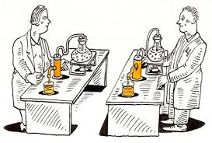
Infrastructure in data science to enable Reproducibility and Portability
In addition to data and analysis, implementation and environment matters
Use this Operating System
Install this software
Configure software this way
Add these packages
Get this data in this format
Run analysis against data
Create plots
Generate report

Slide 24
Best practices: Version control
Reproducibility applies to your own attempts (not just other people)
Regardless of how you develop analytics, you'll be creating or editing software, code and documents.
[Lesson] Regardless of how you implement best practices, avoid inventing solutions for which someone else already provided a path.
Suggested resource: https://try.github.io/

Slide 25
What ARE WE NOT COVERING?

Slide 26

Not covered: product integration
There's a complex network of dependencies (i.e. software engineers, managers) of which data science is one component.
Downstream consumers of your output are likely to be software developers who use containers and support users.
This class is focused on the data science; not with integration.
See: http://dev2ops.org/2010/02/what-is-devops/

Slide 27

Not covered: security
This course is just an introduction course to prepare you for the remaining classes.
Security is not covered at all.
Notes:
https://betanews.com/2014/04/15/windows-8-1-without-update-will-no-longer-receive-security-updates/

Slide 28
SOFT SKILLS

Slide 29
DS is more than Math and Software
Human interaction in data science
Discovering stakeholders
Negotiating with data owners
Customer engagement
https://hbr.org/2017/01/the-best-data-scientists-get-out-and-talk-to-people

Slide 30
Iterating with customers
As a data scientist, you'll often be working for someone other than yourself by providing insights on data
Expect under-specified requirements from customers. Iterate.
Provide incomplete solutions rather than waiting until the product is perfect.
https://en.wikipedia.org/wiki/Minimum_viable_product

Slide 31
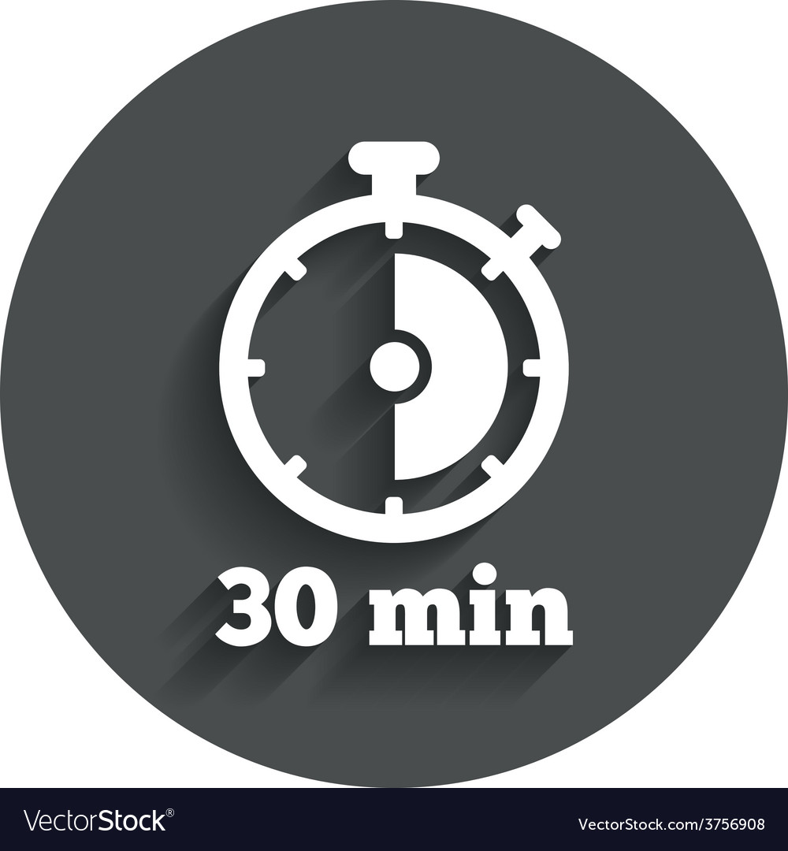
When to persist, When to change course, When to seek help
Try attacking the challenge for 30 minutes
Then seek help (i.e., instructor or grader) or do something else for a while
https://en.wikipedia.org/wiki/Pomodoro_Technique
Notes:
http://finalfantasy.wikia.com/wiki/Level_grinding
https://en.wikipedia.org/wiki/Grinding_(gaming)
https://www.vectorstock.com/royalty-free-vector/timer-sign-icon-30-minutes-stopwatch-symbol-vector-3756908

Slide 32
Pro-tip when seeking help
How to ask well-formed questions:
https://stackoverflow.com/help/how-to-ask
[Intentional sidetrack to StackOverflow]
Ask technical questions:
Poor: "I don't understand Python dictionaries" (--> online tutorials)
Better: "When is it appropriate to use a key-value pair?"
Poor: If I submitted this assignment as is, what score would I get?
Better: I am planning to submit the attached assignment, but currently there's an error in the third cell. I've searched online but don't find any references to the error message. Can you provide guidance?

Slide 33

Emotions in Data Science
As a data scientist, most of your time will be spent in a desert of uncertainty, frustration, and doubt.
There will be rare short-lived spikes of excitement and happiness due to events like getting a new dataset, creating a new analytic, getting a new result, or being thanked by a stakeholder.
This experience is normal and does not go away.
See also the psychology of slot machines
Notes:
https://www.vhtcx.com/wp-content/uploads/2015/02/canstockphoto3986275.jpg
https://www.vhtcx.com/blog/5-causes-customer-frustration-fix/

Slide 34
Reading Suggestions
50 years of data science
A Very Short History Of Data Science
Action: Read, write, tell
News and blogs
https://www.kdnuggets.com/
https://news.ycombinator.com/
https://hackernoon.com/
https://www.reddit.com/r/datascience/
https://dataelixir.com/newsletters/
https://insidebigdata.com/
https://ai.googleblog.com/
Notes:
Timeline: http://www.dataversity.net/brief-history-data-science/

Slide 35
Some Online Resources
Meetups
https://www.meetup.com/topics/data-science/
https://www.meetup.com/DataWorks/
https://www.meetup.com/Statistical-Seminars-DC/
Others
Salaries: https://www.burtchworks.com/category/salary/
A weekly social data project in R: https://github.com/rfordatascience/tidytuesday
Datasets to work with
https://datasetsearch.research.google.com/
https://datacatalog.worldbank.org/
https://opendata.maryland.gov/

Slide 36
Data Sets Online Resources
Title | Description | Link | Comment
Github | Used by many developers to share code and collaborate. | https://github.com/ | Class code is hosted in this website.
U.S. Government’s Open Data | Data, tools, and resources to conduct research, develop web and mobile applications, design data visualizations, and more. | https://data.gov/ | Real world datasets that in some cases may be extremely large.
Kaggle | Host data science competitions, datasets, Jupyter notebooks, etc. | https://www.kaggle.com/ | Good source for datasets and Jupyter Notebooks.
Google Research Data | Google Dataset Search Engine | https://datasetsearch.research.google.com/ | Search engine for datasets. May send you to data in other websites in this table.
World Bank Data | Data collections by the World Bank | https://datacatalog.worldbank.org/ | Also has collections from various sources.
Maryland Government Data | MD Open Data Website. | https://opendata.maryland.gov/ | Real world datasets from Maryland’s State Government

Slide 37
Visualization Examples and Online Resources
Title | Description | Link | Comments
MatPlotLib Example Gallery | Python Plotting Library | https://matplotlib.org/stable/gallery/index.html | Library included in Anaconda.
Seaborn Example Gallery | Python Plotting Library | https://seaborn.pydata.org/examples/index.html | Library included in Anaconda.
Plotly Example Gallery | Python Plotting Library | https://plotly.com/python/ | Library included in Anaconda.
D3.JS | Data Driven Documents Visualization Library | https://d3-graph-gallery.com/ | Used to deploy dynamic website plots.
Five Thirty Eight | Interactive Dashboard Examples | https://projects.fivethirtyeight.com/ | Excellent Website that provides great examples on the capabilities of dashboards and data analytic visualizations.
More examples of online resources in the Data Science Reference Guide in the main directory of Data 601 Github page.

